Slide 1
2024 Cooke City Area secondary analysis and potential scenario impacts

Slide 2
Table of contents
 | Slide Number
Introduction | 03
Regional Tourism Overview | 04
Lodging Facility Use Tax Collection | 10
Cooke City/Silver Gate/Colter Pass Resort Tax | 15
Scenario Development | 20
Conclusions & Key Takeaways | 30

Slide 3
Introduction
The purpose of this study phase is multi-faceted including:
To explore tourism spending by season using ITRR’s comprehensive data;
To identify trends in resort and lodging tax data;
And, to use these data and the information garnered from the previous phases to build scenarios that explore how changes in recreational access impact the local area and beyond.
While much of the secondary data comes from Montana, Wyoming implications are also highlighted throughout using current research.

Slide 4
Regional tourism overview

Slide 5
Visitation overview
2023 Montana nonresident traveler expenditures & economic contribution
In 2023, nonresident visitors to Montana spent an estimated $5.45 billion in the state.
On average, traveling groups spent $195 per day while in Montana
44% of groups arrive in the 3rd quarter (Jul-Sep) and spend 5.7 nights in the state, while 13% arrive in 1st quarter (Jan-Mar) and spend 4.1 nights.
Quarter 1 contributes 11% to total expenditures, while quarter 3 contributes 52%
Nonresident spending contributes $8.21 billion in total economic output
Grau, Kara, "2023 Estimates - Nonresident Visitation, Expenditures, and Economic Contribution" (2024). Institute for Tourism and Recreation Research Publications. 459. https://scholarworks.umt.edu/itrr_pubs/459

Slide 6
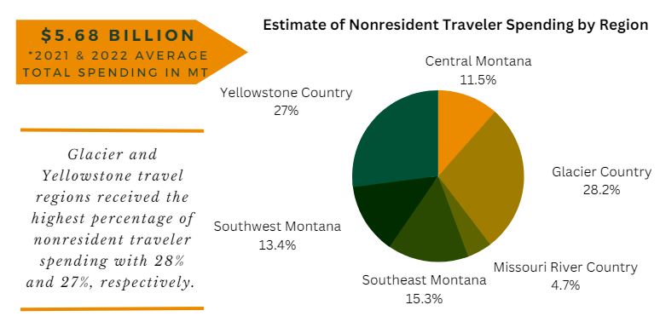
Visitation overview
2022 Yellowstone country nonresident traveler expenditures & economic contribution
In 2022, nonresident visitors to Yellowstone Country spent an estimated $1.54 billion in the region, contributing $2.3 billion in total economic output.
Grau, Kara, "Montana Travel Region & Counties - Economic Contribution of 2021/2022 Averaged Nonresident Travel Spending" (2023). Institute for Tourism and Recreation Research Publications. 446.
https://scholarworks.umt.edu/itrr_pubs/446

Slide 7
Visitation overview
2022 park county nonresident traveler expenditures & economic contribution
In 2022, nonresident visitors to Yellowstone Country spent an estimated $337 million in the county, contributing $396 million in total economic output.
Park County ranked 6th in nonresident spending in 2022.
Grau, Kara, "Montana Travel Region & Counties - Economic Contribution of 2021/2022 Averaged Nonresident Travel Spending" (2023). Institute for Tourism and Recreation Research Publications. 446.
https://scholarworks.umt.edu/itrr_pubs/446

Slide 8
Visitation overview
Highlights of Year-Round Visitors to Park County and Cooke City
Full Year | Park County | Cooke City
Years Averaged | 2015-2019; 2021-2023 | 2015-2019; 2021-2023
Surveys in Sample | 6,565 | 616
Estimated Average Annual Visitors | 4,571,000 | 349,000
Average Nights in Montana | 5.8 | 6.8
Proportion of Nights in Yellowstone Country | 40% | 61%
Proportion indicating their primary reason for travel is Vacation, Recreation, Pleasure | 51% | 79%
If on vacation and Yellowstone was primary reason | 24% | 37%
If on vacation and snowmobiling was primary reason | <1% | 2%
If on vacation, participating in Snowmobiling is one of several reasons | 1% | 2%
Average Group size | 2.3 | 2.3
Top 3 Origins (in order) | WA, ID, MN | ID, MN, WA
Across an average year, 7.6% of Park County visitors also passed through Cooke City.
Visiting Yellowstone NP was the most cited primary reason for visiting for those on vacation.
Those traveling through Cooke City were most often from ID, MN, and WA.
Institute for Tourism and Recreation Research – Interactive Dashboards: https://www.umt.edu/tourism-recreation-research/interactive-data/default.php

Slide 9
Visitation overview
Highlights of 1st Quarter Visitors to Park County and Cooke City
Across an average 1st Q, 3.3% of Park County visitors also passed through Cooke City.
Skiing/Snowboarding was the most cited primary reason for visiting for those on vacation and passing through Park County. Visiting Yellowstone NP dropped to 3rd.
Those traveling through Cooke City were most often from WY, WA, and ND.
Snowmobiling was the most frequently cited primary reason for traveling for those passing through Cooke City.
1st Quarter | Park County | Cooke City
Years Averaged | 2015-2019; 2021-2023 | 2015-2019; 2021-2023
Surveys in Sample | 667 | 34
Estimated Average Quarterly Visitors | 395,000 | 9,000
Average Nights in Montana | 4.7 | 9.2
Proportion of Nights in Yellowstone Country | 50% | 78%
Proportion indicating their primary reason for travel is Vacation, Recreation, Pleasure | 30% | 68%
If on vacation and Yellowstone was primary reason | 17% | 15%
If on vacation and snowmobiling was primary reason | 9% | 40%
If on vacation, participating in Snowmobiling is one of several reasons | 12% | 55%
Average Group size | 2.0 | 2.5
Top 3 Origins (in order) | WY, ND, ID | ND,WA,SK
Caution: Cooke City Q1 sample consists of only 34 observations.
Institute for Tourism and Recreation Research – Interactive Dashboards: https://www.umt.edu/tourism-recreation-research/interactive-data/default.php

Slide 10
Lodging facility use Tax Collection

Slide 11
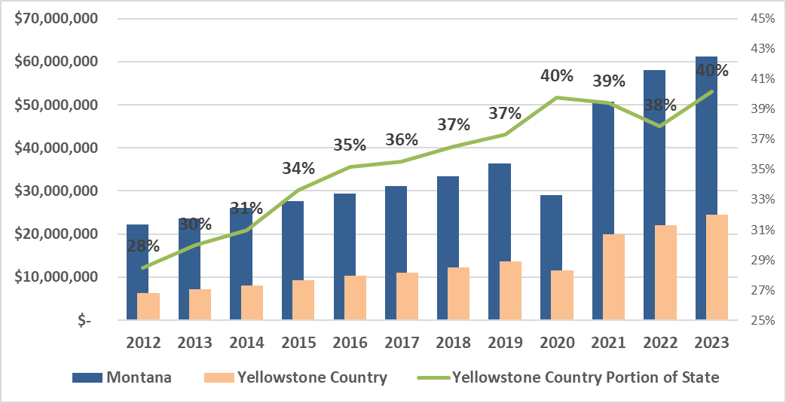
“Bed Tax” Collections
Annual Lodging Facility Use Tax (4%) in Montana and Yellowstone country
On average, Yellowstone Country collection of the bed tax makes up 35% of the statewide total (2012-2023).
Both the state and region hit all–time highs in 2023.
BrandMT- Lodging Facility Use Tax: https://brand.mt.gov/Programs/Office-Of-Tourism/Lodging-Facility-Use-Tax

Slide 12
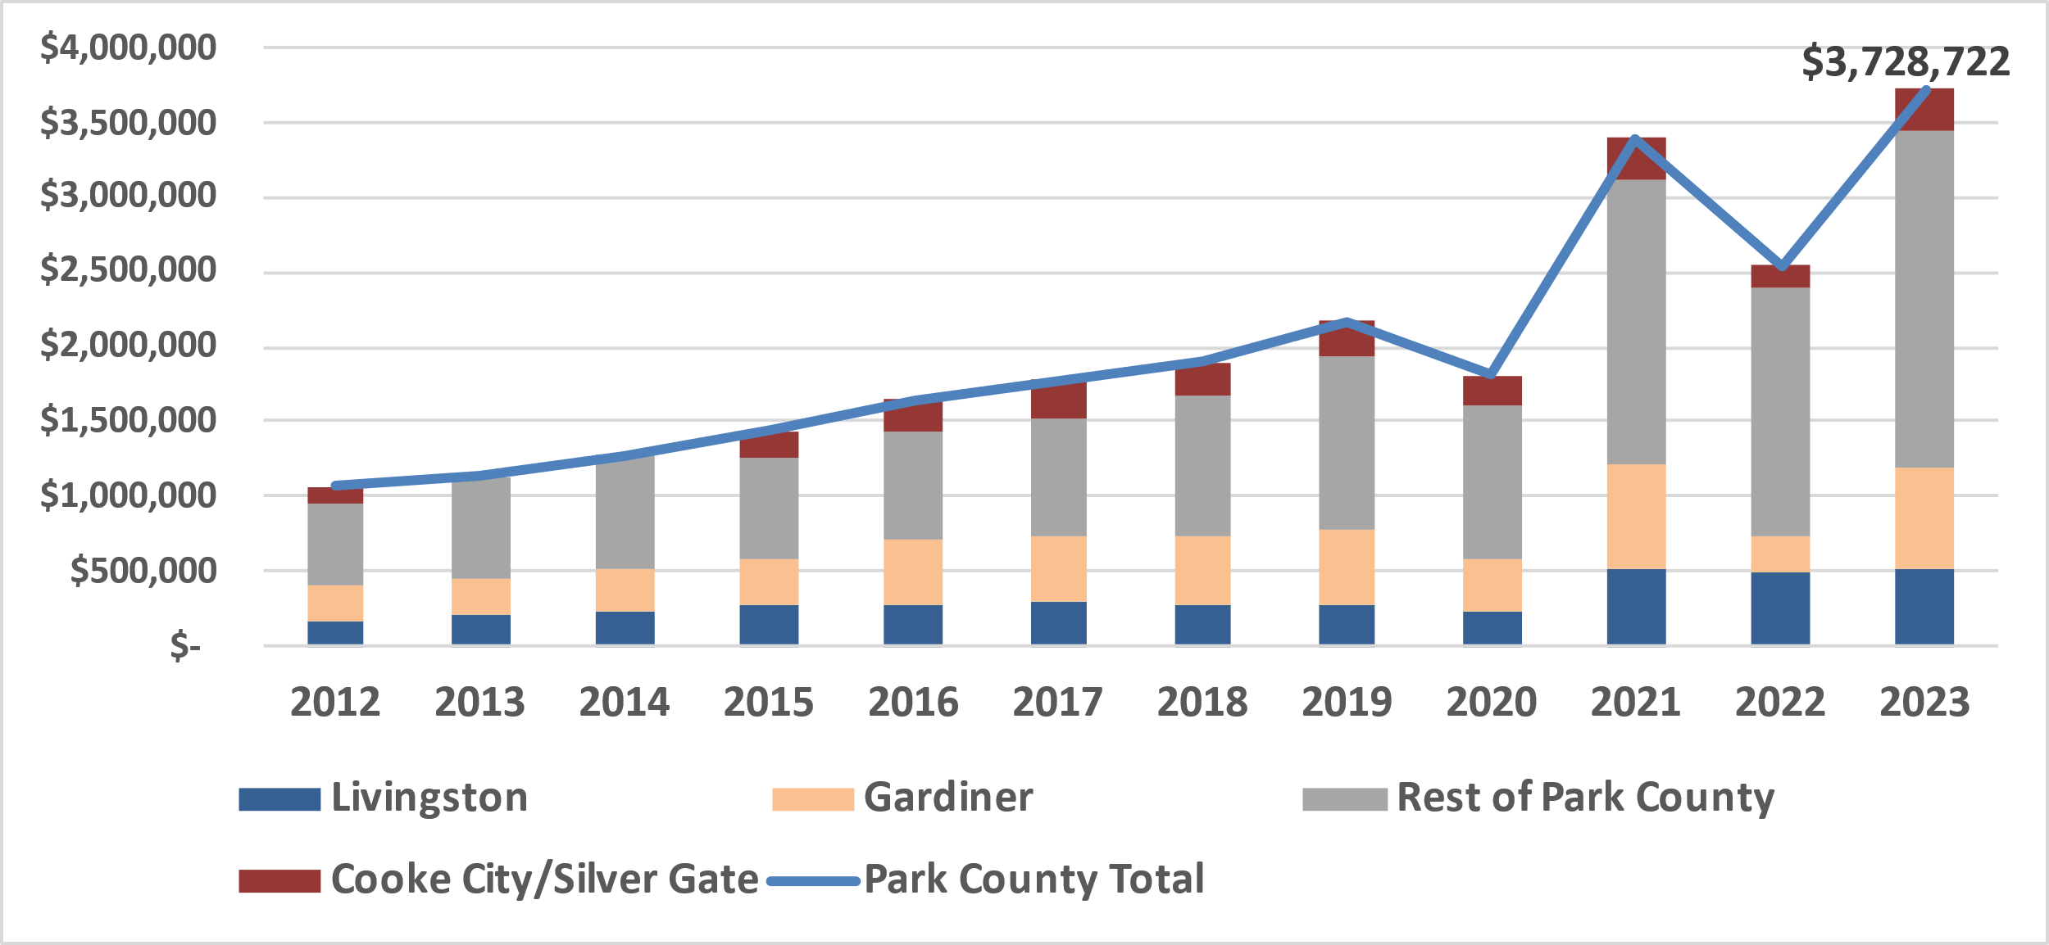
“Bed Tax” Collections
Annual Lodging Facility Use Tax (4%) in Park county and communities
Park County makes up 17% of bed tax collections of Yellowstone Country.
Cooke City and Silver Gate areas make up 11% of Park County collections on average.
2013 and 2014 Cooke City/Silver Gate data not currently available.
BrandMT- Lodging Facility Use Tax: https://brand.mt.gov/Programs/Office-Of-Tourism/Lodging-Facility-Use-Tax
Cooke City/Silver Gate data provided directly from MT Department of Revenue. Currently available data is 2008-2012; 2015-2023)

Slide 13
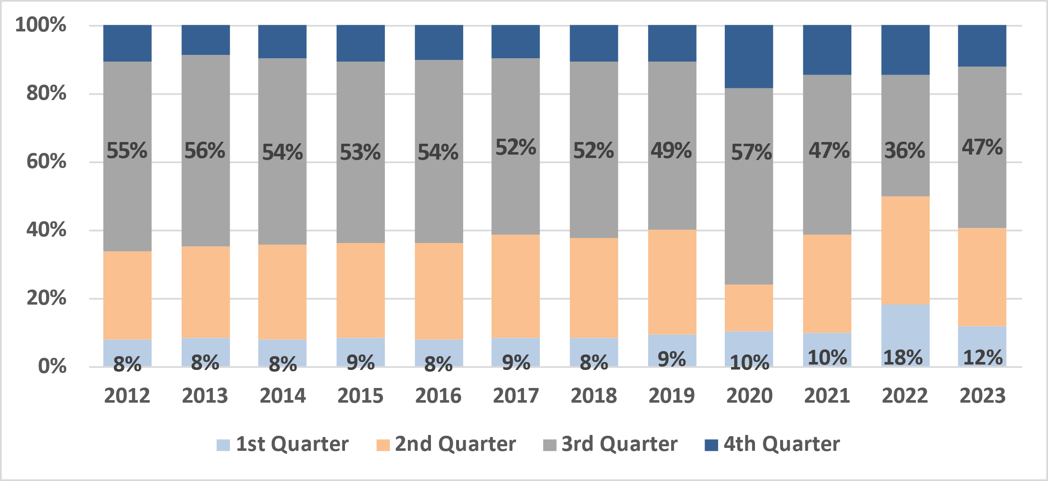
“Bed Tax” Collections
Quarterly Lodging Facility Use Tax (4%) in Park County
On average, 51% of Park County bed tax is collected in the 3rd Quarter (July-Sept).
On average, 10% of Park County bed tax is collected in the 1st Quarter (Jan-Mar).
BrandMT- Lodging Facility Use Tax: https://brand.mt.gov/Programs/Office-Of-Tourism/Lodging-Facility-Use-Tax

Slide 14
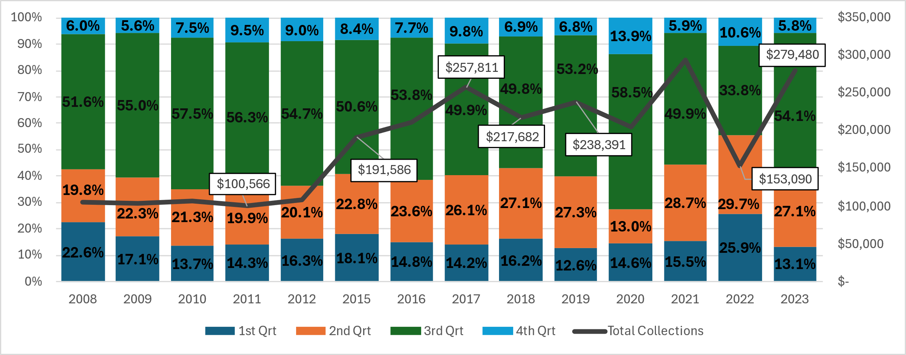
“Bed Tax” Collections
Quarterly Lodging Facility Use Tax (4%) in Cooke City/Silver Gate
On average, 52% of Cooke City/Silver Gate is collected in the 3rd Quarter (July-Sept)
On average, 16% of Cooke City/Silver Gate is collected in the 1st Quarter (Jan-Mar)
2013 and 2014 Cooke City/Silver Gate data not currently available.
Note: 2022 is substantially different than other years. Likely resulting from the severe flooding that occurred in June.
BrandMT- Lodging Facility Use Tax: https://brand.mt.gov/Programs/Office-Of-Tourism/Lodging-Facility-Use-Tax
Cooke City/Silver Gate data provided directly from MT Department of Revenue.

Slide 15
Cooke city, silver gate, and colter pass resort tax

Slide 16
history
The Cooke City resort tax was enacted in 2006, at a rate of 3% of the retail value of all luxury goods and services. Revenues were initially allocated to:
1% for county administration;
5% percent for merchant collection fees;
10% for property tax relief to property owners within the area;
84% for capital improvements, emergency services, tourism development, and other local projects as identified which provide for the public health, safety, and welfare within the resort area.
Since 2021, 25% has been allocated to Sewer Project Improvements, reducing property tax relief to 8% and capital improvement + merchant fees to 67%.
Park County Ordinance No 18: https://www.parkcounty.org/uploads/files/departments/35/Cooke-City-Ordinance.pdf
Grau, Kara, "An Assessment of the Resort Tax: Collections and Usage in Montana Communities" (2016).
Institute for Tourism and Recreation Research Publications. 347.
https://scholarworks.umt.edu/itrr_pubs/347

Slide 17
history
The tax is collected year-round on all goods and services sold within the resort area by the following establishments:
Hotels, motels, and other lodging or camping facilities;
Food purchased unprepared or unserved is among the exempt goods and services.
Restaurants, fast food stores, and other food establishments;
Taverns, bars, nightclubs, lounges, and other public establishments that serve beer, wine, liquor, or other alcoholic beverages by the drink; and
Destination ski resorts and other destination recreational facilities.
Previous uses have included:
1) Construction of a Community Center,
2) Upgrades to equipment for the fire department and emergency medical services, snowmobile trail grooming equipment, and water systems.

Slide 18
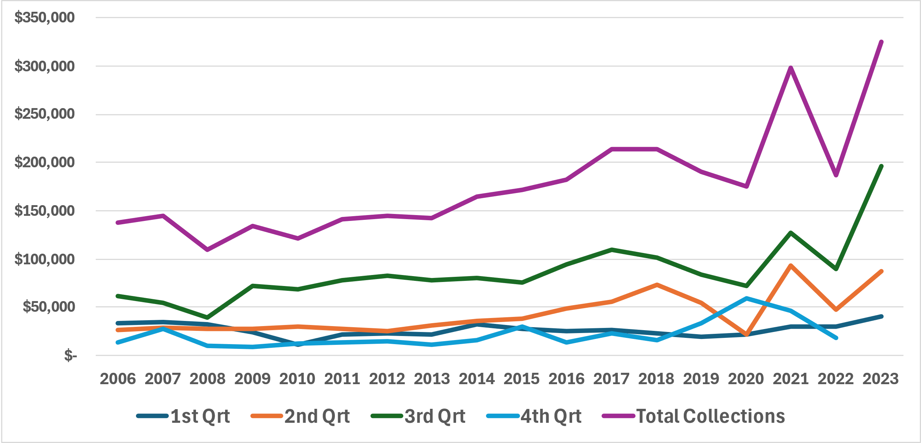
Resort tax collections
Year | Total Collections
2006 | $ 137,291.52
2007 | $ 144,712.19
2008 | $ 110,042.72
2009 | $ 134,308.28
2010 | $ 121,204.77
2011 | $ 140,775.04
2012 | $ 145,356.77
2013 | $ 141,973.13
2014 | $ 164,546.08
2015 | $ 172,180.38
2016 | $ 182,504.02
2017 | $ 213,699.51
2018 | $ 213,296.65
2019 | $ 190,762.50
2020 | $ 174,645.90
2021 | $ 297,902.99
2022 | $ 186,860.36
2023 | $ 324,668.21

Slide 19
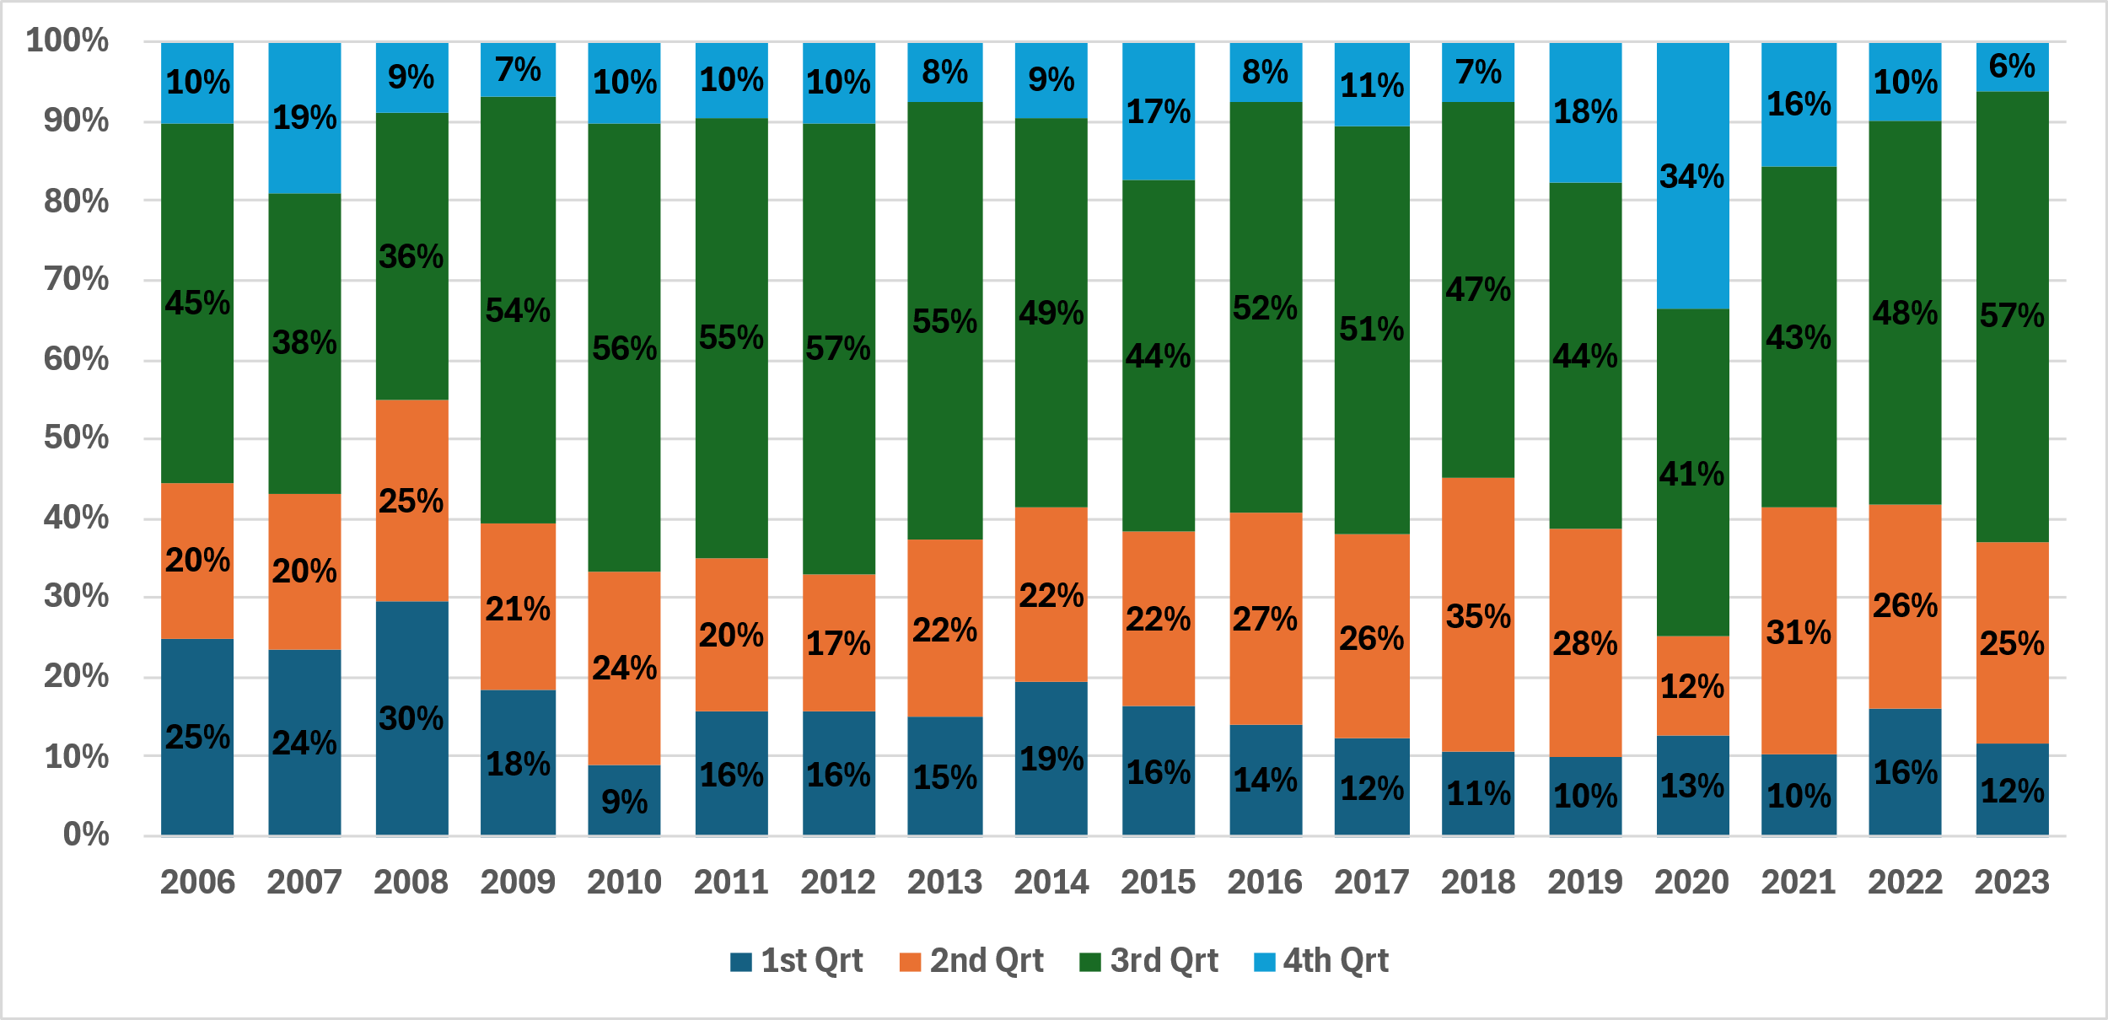
Resort tax – Quarterly Proportions
On average, the 3rd quarter (July-Sept) yields 49% of total collections.
1st quarter (Jan-Mar) yields 16%.

Slide 20
Scenario development

Slide 21
Scenarios explored via surveys
Regional survey hypothetical scenarios provided to respondents:
(1) Open and maintain US 212 East of Cooke City and add replacement trails and additional parking.
(2) Open and maintain US 212 East of Cooke City with no additional actions.
(3) Continue to leave US 212 East of Cooke City unplowed and closed to vehicle traffic in the winter.
Scenario 1 yielded the highest average rating (3.6) among WY respondents, followed by option 2 (3.4).
Both yielded an average that suggests an increase in potential visitation during periods that are currently unplowed. Scenario 3 yielded an average less than “no change” (2.3). - See next slide.
Montana respondents averaged near “no change” for all options.

Slide 22
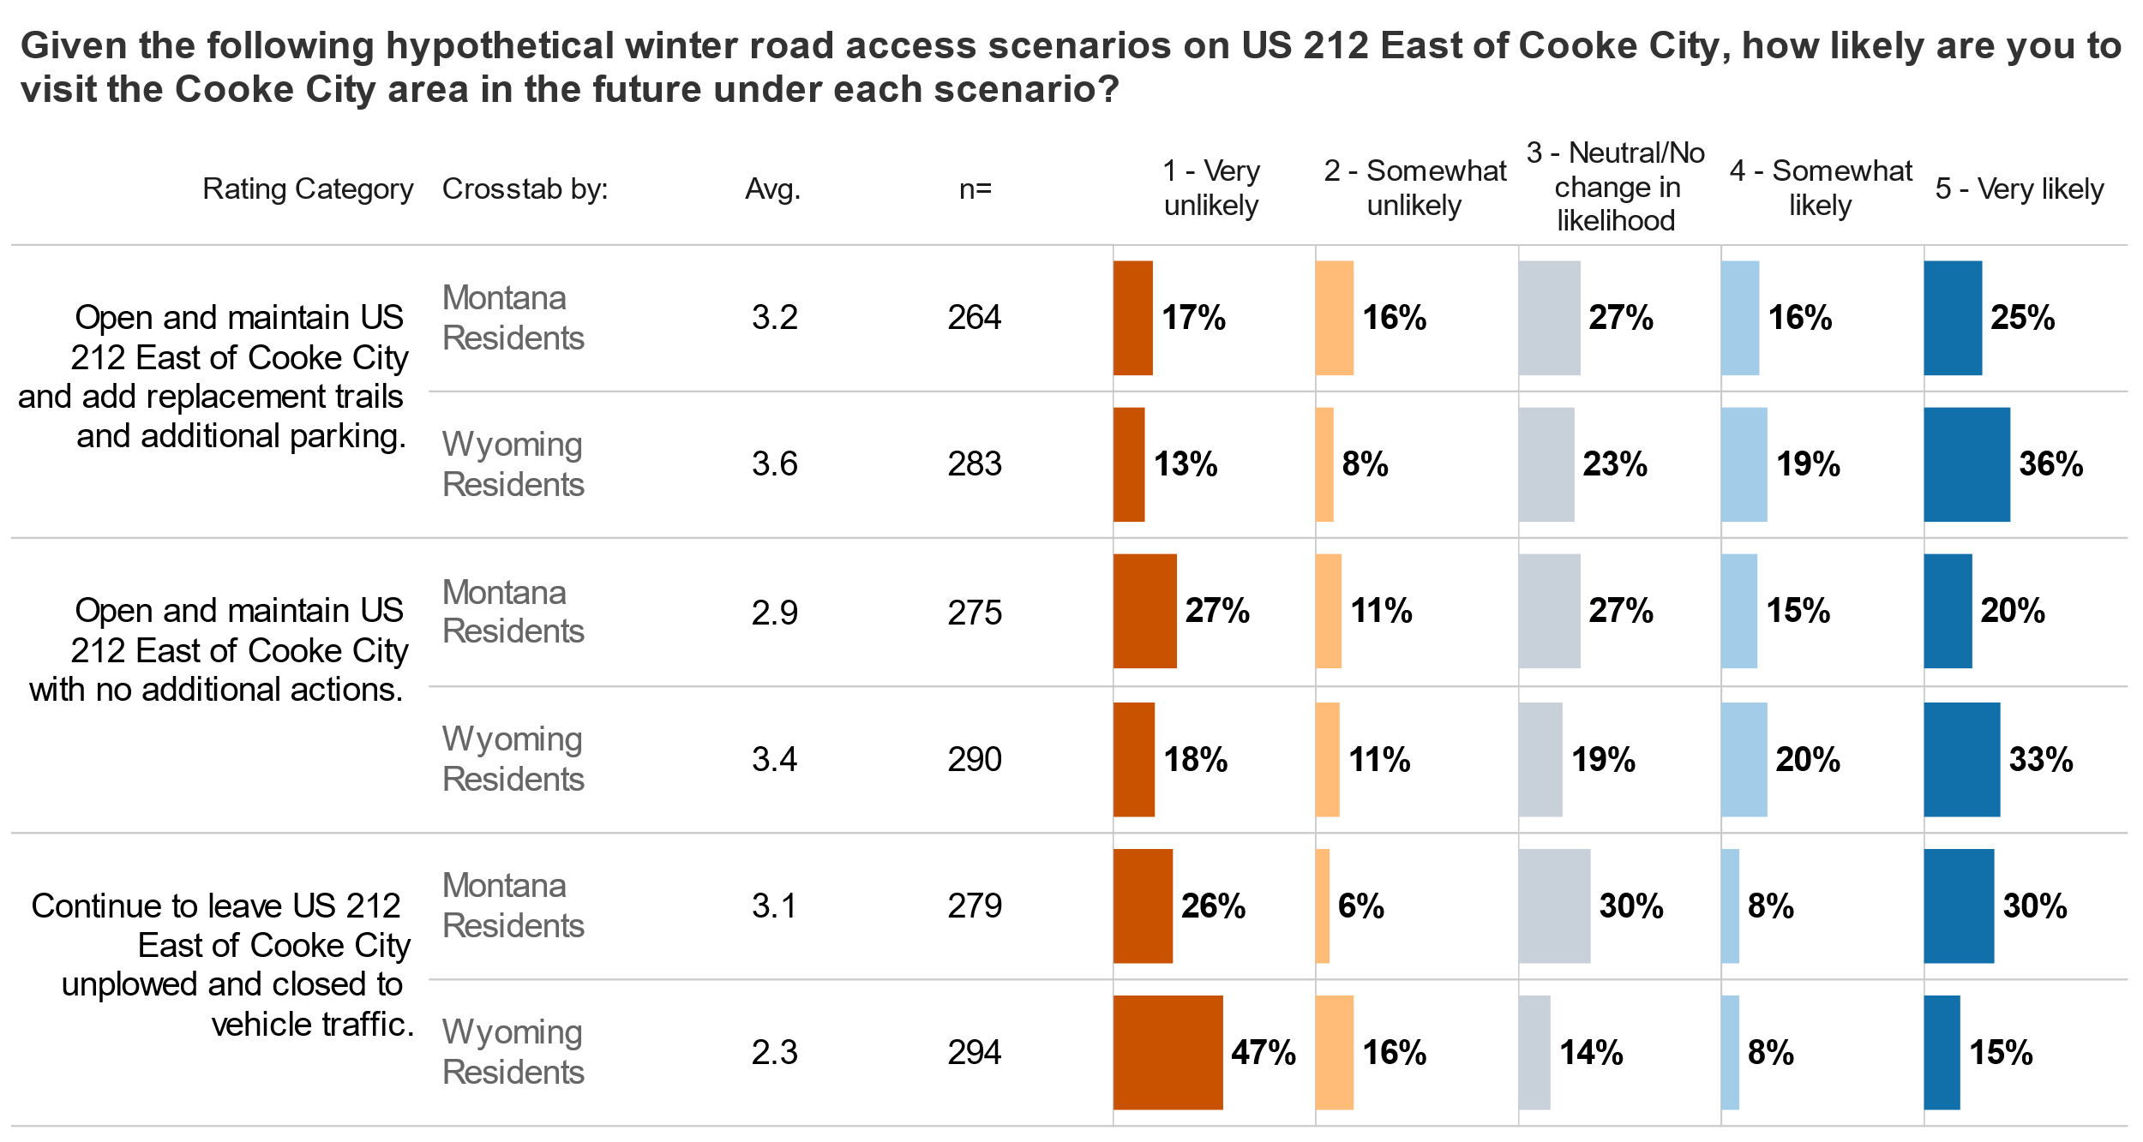
Hypothetical scenarios: Regional Respondents

Slide 23
Hypothetical scenarios: Regional Respondents

Slide 24
Hypothetical scenarios: Regional Respondents
Under the scenario: Open and maintain US 212 East of Cooke City and add replacement trails and additional parking:
WY residents responded with a stated interest in increased visitation across all activity types inquired about.
Going to Cooke City to participate in nature viewing – 3.8 (out of 5.0);
Going to Cooke City to participate in motorized snowsports -3.2;
Going to Cooke City to participate in nonmotorized snowsports – 3.5;
Going to Cooke City for general recreation/leisure – 3.8
Take trips to recreate in Yellowstone NP – 3.8.
MT residents tended closer to no change across all categories – see next slide.

Slide 25
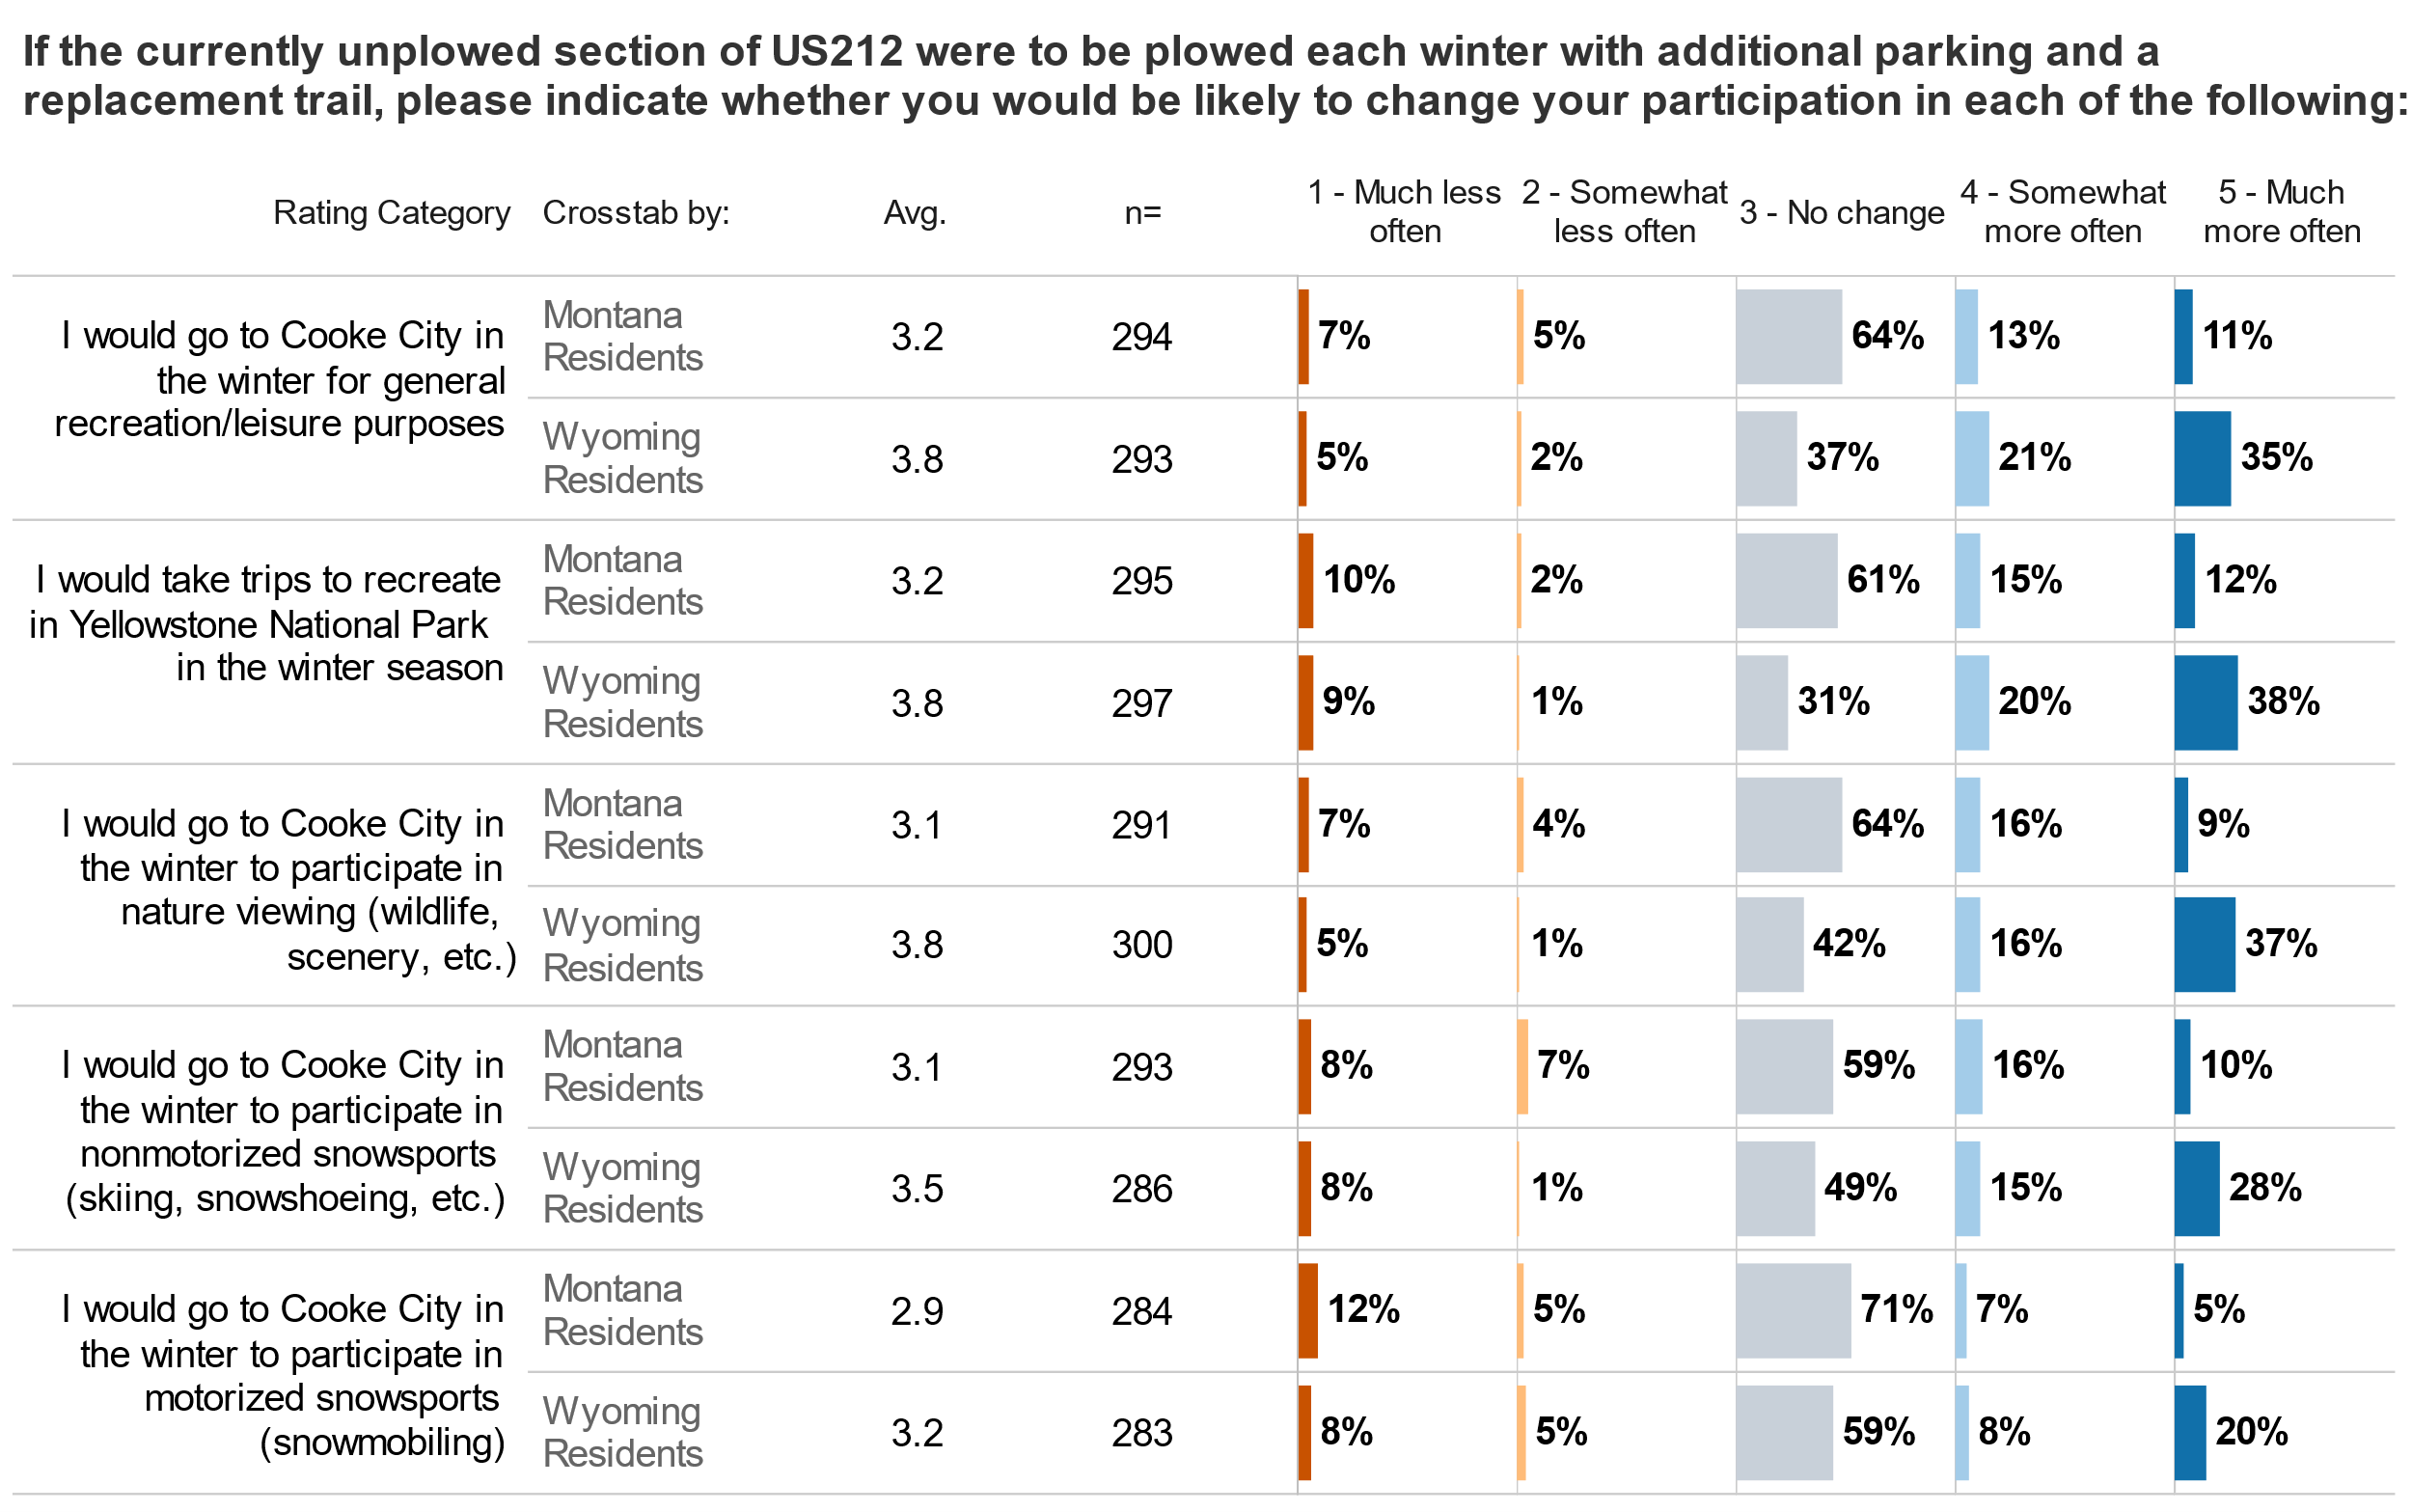
Hypothetical scenarios: Regional Respondents

Slide 26
Scenarios explored via surveys
Visitor survey hypothetical scenarios provided to respondents:
As a visitor to the area, would you prefer to have US 212 east of Cooke City plowed during the winter season?
How would plowing US 212 east of Cooke City, without adding any replacement trails or parking, influence your likelihood to visit Cooke City/Silver Gate Area for winter recreation?
How would plowing US 212 east of Cooke City, with the addition of replacement trails and parking, influence your likelihood to visit Cooke City/Silver Gate Area for winter recreation?

Slide 27
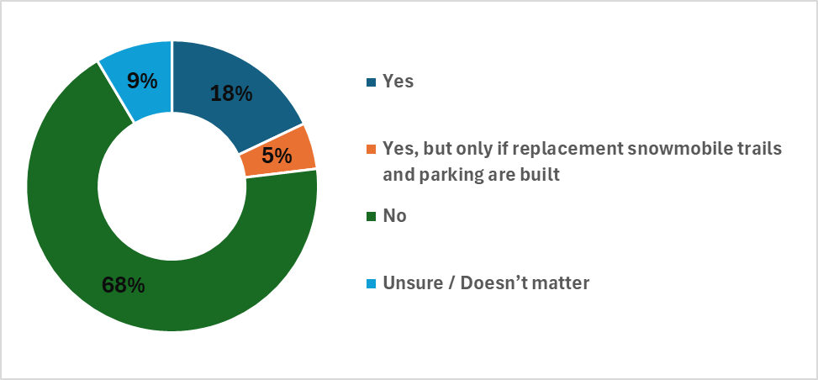
Hypothetical scenarios: visitors
As a visitor to the area, would you prefer to have US 212 east of Cooke City plowed during the winter season?
A strong majority of respondents (n=117) indicated they preferred the section of US 212 to remain unplowed.

Slide 28
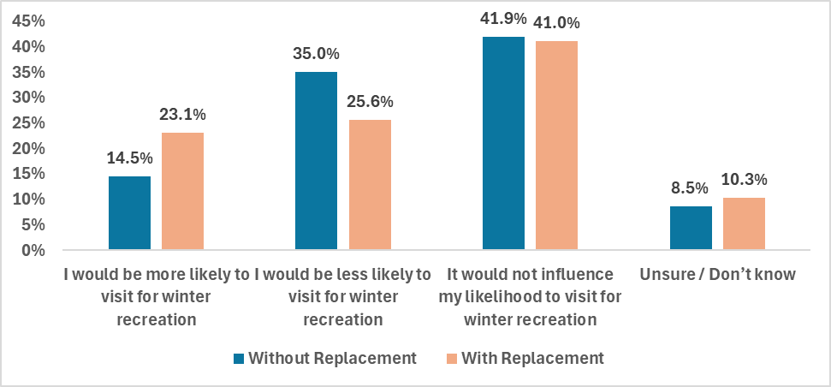
Hypothetical scenarios: visitors
How would plowing US 212 east of Cooke City, without adding any replacement trails or parking, influence your likelihood to visit Cooke City/Silver Gate Area for winter recreation?
How would plowing US 212 east of Cooke City, with the addition of replacement trails and parking, influence your likelihood to visit Cooke City/Silver Gate Area for winter recreation?
Under the scenario in which no replacement trails or additional parking are provided, respondents (n=117) indicate a net 20.5% reduction in the likelihood of visiting for winter recreation. However, this net reduction is reduced to 2.5% if replacement trails and parking are provided.
If respondents entered Cooke City on a snowmobile via US 212 (n=22), 6 indicated they would be more likely to visit, 4 indicated less likely, 10 indicated no influence, and 2 were unsure, under the condition that a replacement trail and parking is created.

Slide 29
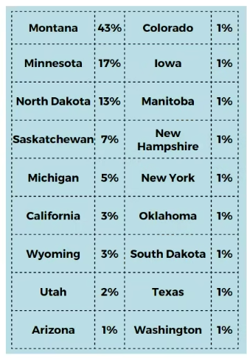
Additional data related to scenarios: Snowmobiling Permits
In 2023, 1,879 known non-resident snow trail passes were issued by vendors in Montana. Leading states/provinces of origin include:
MN-396, ID-234, ND-224, WA-205, WI-156, AB-81
In the 2024 winter visitor survey, Montana respondents were most likely (94%) to have driven in from Gardiner. 67% of Minnesota respondents indicated a similar arrival mode.
Respondent Origins – 2024 Winter Visitor Survey

Slide 30
CONCLUSION & KEY TAKEAWAYS

Slide 31
Key findings: Expected Status Quo – No Plowing
Lodging Tax / Resort Tax
All else remaining the same, revenue in quarter one may be expected to remain consistent with previous years, making up approximately 16% of total annual revenue and increasing at an average annual rate of 1-2%.
Visitation/Expenditures
4,500 groups on average visiting and/or staying overnight in quarter 1.
Ave Daily Spend = $196.21 per group per day, of which roughly $100 is subject to resort tax.
Visiting groups in the winter report to stay 3.95 days in Cooke City area.
Yields roughly $1.5-$1.8 million in taxable spending in the area, generating funds for property tax relief, sewer upgrades, and other capital improvements.
Resident Concerns and Challenges
Winter access to/from Cooke City area remains one of the most cited (45% of respondents) challenges for those living in the great Cooke City area, with 1/3 of respondents indicating it as their top concern.
Emergency services was the top-rated quality of life attribute scored by area residents (4.5 out of 5). While it drops to a score of 3.7 (out of 5) in satisfaction with performance, 62% of respondents provided it a score of 4 or greater.

Slide 32
Key findings: Expected Changes – Plow and no replacement
Current Visitation Change
Based on the survey conducted of winter visitors in Cooke City, a net reduction of 20.5% in the likelihood of visiting is predicted. Should this result in an actual loss of 20.5% in visitation during quarter one:
Total visitation reduced to 3,578 groups; loss of 923.
Taxable spending in the area may be reduced to $1.2-$1.4 million
Overall annual spending in the area, as well as resort and lodging tax collections could be expected to be reduced by 3-4%.
Enticing New Visitation
Park County, MT residents largely express no change in their likelihood of visiting the Cooke City area in the winter, thus no expected change in spending from these residents.
Park County WY residents did express some increased likelihood (3.4 on a scale of 5, with 5= Very Likely) of visiting the area for winter recreation, with 33% indicating very likely. Given the proximity of these Park County WY residents, it is likely that their length of stay in the area will be considerably shorter than the 3.95 days of current visitors; roughly 1/3 of the length of stay. Thus, it would require roughly 3,000 group visits per winter to offset the potential loss in current visitors.
Resident Concerns and Challenges
Plowing without replacement may address the voiced concern of Cooke City residents regarding winter access and potentially increase performance satisfaction with emergency services.

Slide 33
Key findings: Expected changes - plow and replace
Current Visitation Change
Based on the survey conducted of winter visitors in Cooke City, a net reduction of 2.5% in likelihood to visit is predicted. Should this result in an actual loss of 2.5% in visitation during quarter one:
Total visitation reduced to 4,388 groups; loss of 113.
Taxable spending in the area may be reduced to $1.4-$1.7 million.
Overall annual spending in the area, as well as resort and lodging tax collections could be expected to be reduced by <0.5%.
Enticing New Visitation
Park County, MT residents largely express a small positive change in their likelihood of visiting the Cooke City area in the winter; (3.2 on a scale of 5, with 5= Very Likely)
Park County WY residents expressed a strong increased likelihood (3.6 on a scale of 5, with 5= Very Likely) of visiting the area for winter recreation, with 36% indicating very likely. Given the proximity of these Park County WY residents, it is likely that their length of stay in the area will be considerably shorter than the 3.95 days of current visitors; roughly 1/3 of the length of stay. Thus, it would require roughly 300 group visits per winter to offset the potential loss in current visitors.
Resident Concerns and Challenges
Plowing without replacement may address the voiced concern of Cooke City residents regarding winter access and potentially increase the performance satisfaction with emergency services.

Slide 34
Key findings
Compared to the rest of Park County, MT, the Cooke City Silver Gate area has a slightly higher quarter 1 (winter) visitation proportion; 16% vs 10%, relative to revenues for the whole year.
Across surveys conducted of residents both in the Cooke City/Silver Gate area, as well as those in the greater Park County WY and MT areas, the option to open and maintain US 212, while also creating alternative trails and parking performed the strongest out of each of those considered.
While current visitors strongly preferred the option to leave US212 unplowed, they indicated only a slight decrease in the likelihood (2.5% net) of visiting if an alternative trail and parking area was established.
Increased interest in winter recreation in the area by both residents of MT and WY Park Counties appears more than sufficient to offset any net loss in current visitors. This increased interest was expressed across recreation types, including motorized sports.
Current resident concerns over winter access may be alleviated under the plow and replace option, though does come at an estimated maintenance cost of roughly $6,000-$7,000 per mile per year.

